Slide 1
Chapter #3: Working with Combinational Logic Contemporary Logic Design Sections 3.2.1 & 3.2.2

Slide 2
Gate Logic: Two Level Simplification
Definition of Terms
implicant: single element of the ON-set or any group of elements
that can be combined together in a K-map
prime implicant: implicant that cannot be combined with another
implicant to eliminate a term
essential prime implicant: if an element of the ON-set is covered by
a single prime implicant, it is an essential prime
Objective:
grow implicants into prime implicants
cover the ON-set with as few prime implicants as possible
essential primes participate in ALL possible covers

Slide 3
Gate Logic: Two Level Simplication
Examples to Illustrate Terms
6 Prime Implicants:
A' B' D, B C', A C, A' C' D, A B, B' C D
essential
Minimum cover = B C' + A C + A' B' D
5 Prime Implicants:
B D, A B C', A C D, A' B C, A' C' D
essential
Essential implicants form minimum cover

Slide 4
Gate Logic: Two Level Simplification
More Examples
Prime Implicants:
B D, C D, A C, B' C
essential
Essential primes form the minimum cover

Slide 5
Gate Logic: Two-Level Simplification
Algorithm: Minimum Sum of Products Expression from a K-Map
Step 1:
Choose an element of ON-set not already covered by an implicant
Step 2:
Find "maximal" groupings of 1's and X's adjacent to that element.
Remember to consider top/bottom row, left/right column, and
corner adjacencies. This forms prime implicants (always a power
of 2 number of elements).
Repeat Steps 1 and 2 to find all prime implicants
Step 3:
Revisit the 1's elements in the K-map. If covered by single prime
implicant, it is essential, and participates in final cover. The 1's it
covers do not need to be revisited
Step 4:
If there remain 1's not covered by essential prime implicants, then
select the smallest number of prime implicants that cover the
remaining 1's

Slide 6
Gate Logic: Two Level Simplification
Example: F(A,B,C,D) = Σ (4,5,6,8,9,10,13) + d(0,7,15)
Initial K-map

Slide 7
Gate Logic: Two Level Simplification
Example: F(A,B,C,D) = Σ (4,5,6,8,9,10,13) + d(0,7,15)
Initial K-map
Primes around
A' B C' D'

Slide 8
Gate Logic: Two Level Simplification
Example: F(A,B,C,D) = Σ (4,5,6,8,9,10,13) + d(0,7,15)
Initial K-map
Primes around
A' B C' D'
Primes around
A' B C' D

Slide 9
Gate Logic: Two-Level Simplification
Example Continued
Primes around
A B C' D

Slide 10
Gate Logic: Two-Level Simplification
Example Continued
Primes around
A B C' D
Primes around
A B' C' D'

Slide 11
Gate Logic: Two-Level Simplification
Example Continued
Primes around
A B C' D
Primes around
A B' C' D'
Essential Primes
with Min Cover

Slide 12
Gate Logic: CAD Tools for Simplification
Quine-McCluskey Method
Tabular method to systematically find all prime implicants
F(A,B,C,D) = Σm(4,5,6,8,9,10,13) + Σd(0,7,15)
Stage 1: Find all prime implicants
Implication Table
Column I
0000
0100
1000
0101
0110
1001
1010
0111
1101
1111
Step 1: Fill Column 1 with ON-set and
DC-set minterm indices. Group
by number of 1's.

Slide 13
Gate Logic: CAD Tools for Simplification
Quine-McCluskey Method
Tabular method to systematically find all prime implicants
F(A,B,C,D) = Σm(4,5,6,8,9,10,13) + Σd(0,7,15)
Stage 1: Find all prime implicants
Implication Table
Column I Column II
0000 0-00
-000
0100
1000 010-
01-0
0101 100-
0110 10-0
1001
1010 01-1
-101
0111 011-
1101 1-01
1111 -111
11-1
Step 1: Fill Column 1 with ON-set and
DC-set minterm indices. Group
by number of 1's.
Step 2: Apply Uniting Theorem
Compare elements of group w/
N 1's against those with N+1 1's.
Differ by one bit implies adjacent.
Eliminate variable and place in
next column.
E.g., 0000 vs. 0100 yields 0-00
0000 vs. 1000 yields -000
When used in a combination,
mark with a check. If cannot be
combined, mark with a star. These
are the prime implicants.
Repeat until no further combinations can be made.

Slide 14
Gate Logic: CAD Tools for Simplification
Quine-McCluskey Method
Tabular method to systematically find all prime implicants
F(A,B,C,D) = Σm(4,5,6,8,9,10,13) + Σd(0,7,15)
Stage 1: Find all prime implicants
Implication Table
Column I Column II Column III
0000 0-00 * 01-- *
-000 *
0100 -1-1 *
1000 010-
01-0
0101 100- *
0110 10-0 *
1001
1010 01-1
-101
0111 011-
1101 1-01 *
1111 -111
11-1
Step 1: Fill Column 1 with ON-set and
DC-set minterm indices. Group
by number of 1's.
Step 2: Apply Uniting Theorem:
Compare elements of group w/
N 1's against those with N+1 1's.
Differ by one bit implies adjacent.
Eliminate variable and place in
next column.
E.g., 0000 vs. 0100 yields 0-00
0000 vs. 1000 yields -000
When used in a combination,
mark with a check. If cannot be
combined, mark with a star. These
are the prime implicants.
Repeat until no further combinations can be made.

Slide 15
Gate Logic: CAD Tools for Simplification
Quine-McCluskey Method Continued
Prime Implicants:
0-00 = A' C' D'
100- = A B' C'
1-01 = A C' D
-1-1 = B D
-000 = B' C' D'
10-0 = A B' D'
01-- = A' B

Slide 16
Gate Logic: CAD Tools for Simplification
Quine-McCluskey Method Continued
Prime Implicants:
0-00 = A' C' D'
100- = A B' C'
1-01 = A C' D
-1-1 = B D
-000 = B' C' D'
10-0 = A B' D'
01-- = A' B
Stage 2: find smallest set of prime implicants that cover the ON-set
recall that essential prime implicants must be in all covers
another tabular method: the prime implicant chart

Slide 17
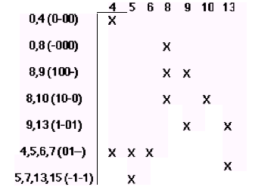
Gate Logic: CAD Tools for Simplification
Prime Implicant Chart
rows = prime implicants
columns = ON-set elements
place an "X" if ON-set element is
covered by the prime implicant

Slide 18
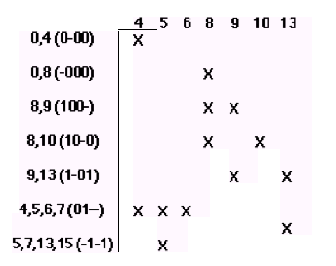
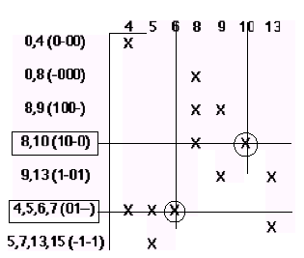
Gate Logic: CAD Tools for Simplification
Prime Implicant Chart
rows = prime implicants
columns = ON-set elements
place an "X" if ON-set element is
covered by the prime implicant
If column has a single X, then the
implicant associated with the row
is essential. It must appear in
minimum cover

Slide 19
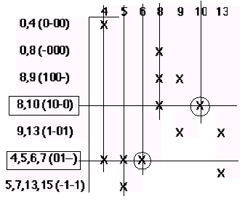
Gate Logic: CAD Tools for Simplification
Prime Implicant Chart (Continued)
Eliminate all columns covered by
essential primes

Slide 20
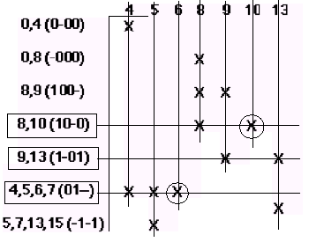
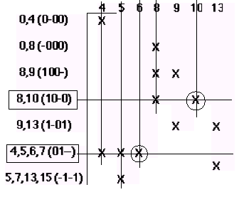
Gate Logic: CAD Tools for Simplification
Prime Implicant Chart (Continued)
Eliminate all columns covered by
essential primes
Find minimum set of rows that
cover the remaining columns
F = A B' D' + A C' D + A' B

Slide 21
Gate Logic: CAD Tools for Simplification
ESPRESSO Method
Problem with Quine-McCluskey: the number of prime implicants
grows rapidly with the number of inputs
n
upper bound: 3 /n, where n is the number of inputs
finding a minimum cover is NP-complete, i.e., a computational
expensive process not likely to yield to any efficient
algorithm
Espresso: trades solution speed for minimality of answer
don't generate all prime implicants (Quine-McCluskey Stage 1)
judiciously select a subset of primes that still covers the ON-set
operates in a fashion not unlike a human finding primes in a K-map

Slide 22
Gate Logic: CAD Tools for Simplification
Espresso Inputs and Outputs
F(A,B,C,D) = Σ (4,5,6,8,9,10,13) + d(0,7,15)
Espresso Input
Espresso Output
.i 4
.o 1
.ilb a b c d
.ob f
.p 10
0100 1
0101 1
0110 1
1000 1
1001 1
1010 1
1101 1
0000 -
0111 -
1111 -
.e
-- # inputs
-- # outputs
-- input names
-- output name
-- number of product terms
-- A'BC'D'
-- A'BC'D
-- A'BCD'
-- AB'C'D'
-- AB'C'D
-- AB'CD'
-- ABC'D
-- A'B'C'D' don't care
-- A'BCD don't care
-- ABCD don't care
-- end of list
.i 4
.o 1
.ilb a b c d
.ob f
.p 3
1-01 1
10-0 1
01-- 1
.e
F = A C' D + A B' D' + A' B

Slide 23
Gate Logic: CAD Tools for Simplification
Espresso Method: Overview
1.
Expands implicants to their maximum size
Implicants covered by an expanded implicant are removed from
further consideration
Quality of result depends on order of implicant expansion
Heuristic methods used to determine order
Step is called EXPAND
Irredundant cover (i.e., no proper subset is also a cover) is extracted
from the expanded primes
Just like the Quine-McCluskey Prime Implicant Chart
Step is called IRREDUNDANT COVER
Solution usually pretty good, but sometimes can be improved
Might exist another cover with fewer terms or fewer literals
Shrink prime implicants to smallest size that still covers ON-set
Step is called REDUCE
Repeat sequence REDUCE/EXPAND/IRREDUNDANT COVER to find
alternative prime implicants
Keep doing this as long as new covers improve on last solution
A number of optimizations are tried, e.g., identify and remove
essential primes early in the process
2.
3.
4.
5.

Slide 24
Gate Logic: CAD Tools for Simplification
Espresso: Why Iterate on Reduce, Expand, Irredundant Cover?
Initial Set of Primes found by
Steps1 and 2 of the Espresso
Method
Result of REDUCE:
Shrink primes while still
covering the ON-set
Choice of order in which
to perform shrink is important
4 primes, irredundant cover,
but not a minimal cover!

Slide 25
Gate Logic: CAD Tools for Simplification
Espresso Iteration (Continued)
Second EXPAND generates a
different set of prime implicants
IRREDUNDANT COVER found by
final step of espresso
Only three prime implicants!

